Slide 1

Reflect on your personal experience duing the first lab.
Mr. Nem Sothea
nempath2021@gmail.com

Slide 2
Content
Describe what you learned while installing and writing your first Java program. What challenges did you face, and how did you overcome them?
How do you imagine applying this Java knowledge in your future jon or career? What kind of project, product, or inductry might ir relate to?

Slide 3
Describe what you learned while installing and writing your first Java program. What challenges did you face, and how did you overcome them?
Challenges Faced
First-time Java programming in VSCode
Setting up the environment (JDK, extensions, configurations)
How I overcome them
Environment Setup:
Followed VSCode’s Java documentation
Installed extensions (e.g., Java Extension Pack)
AI Assistance:
Used GitHub Copilot for:
Code suggestions
Debugging help
Best practice

Slide 4
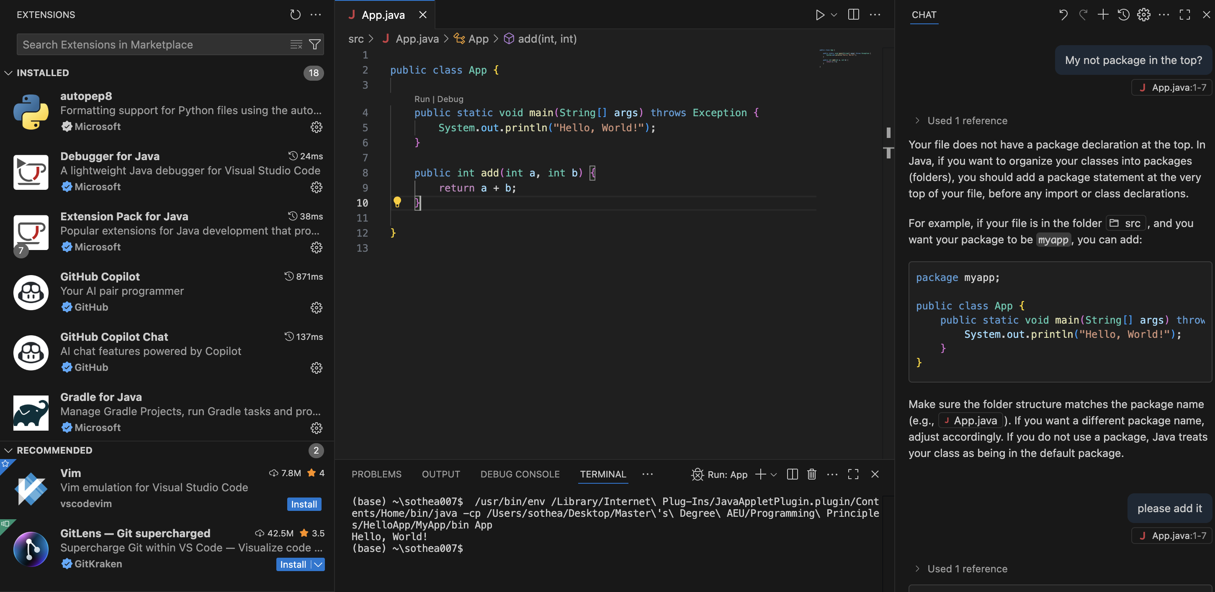
Result
Extensions
Block of Code
Copilot AI
Result

Slide 5
How do you imagine applying this java knowledge in your future job or career? What kind of project, product, or industry might it relate to?
Java in My Career – A We-HR Project
Why Java?
Versatile for enterprise applications
Strong ecosystem for backend systems
Project idea: We-HR System
Features:
Employee/student attendance tracking
Leave management (approvals, records)
Scalable for companies/universities

Slide 6
Reference
https://code.visualstudio.com/docs/languages/java
https://code.visualstudio.com/docs/java/java-tutorial
https://www.oracle.com/java/technologies/downloads/
Thank you.

